Slide 1
Eva in 3 Encounters How SHR changes the Healthcare Game Also available on GitHub: https://github.com/standardhealth/shr_design/tree/master/design/presentations 4.Oct.2016

Slide 2
Light Encounter Julia sprains her ankle

Slide 3
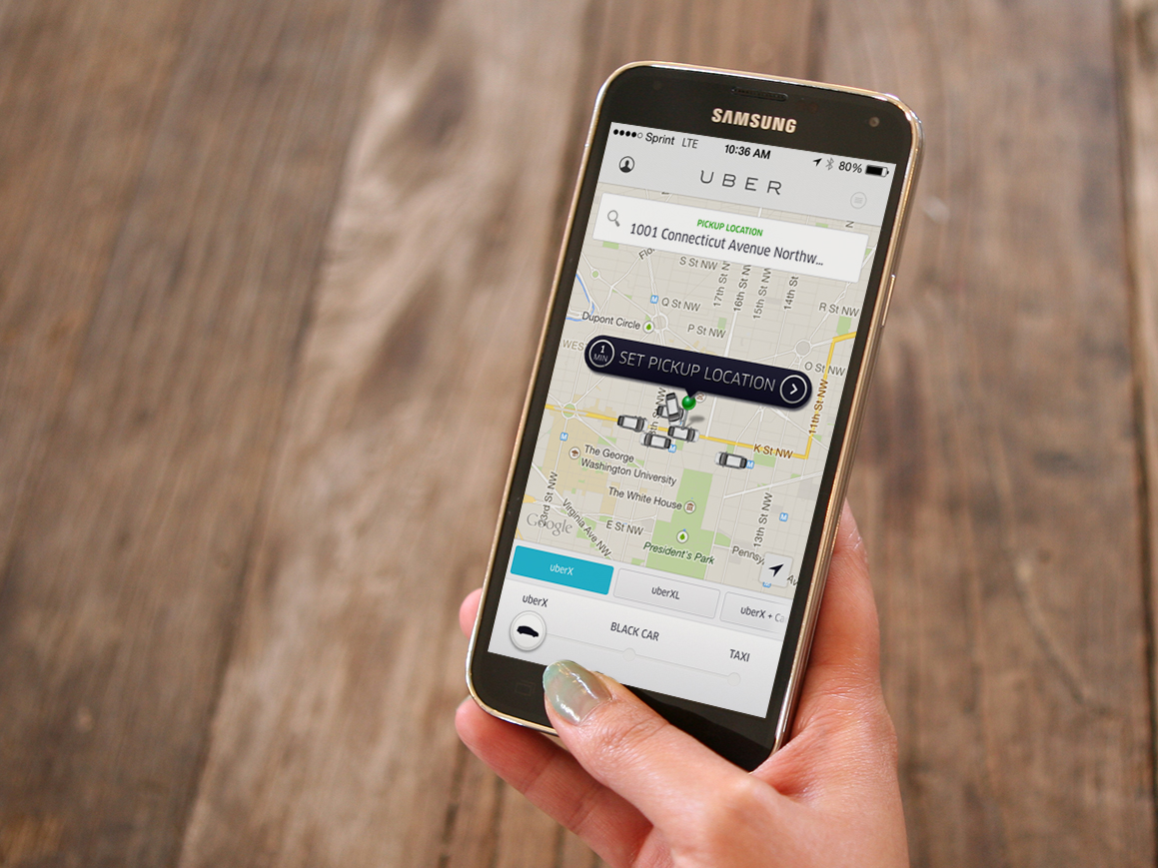

Slide 4
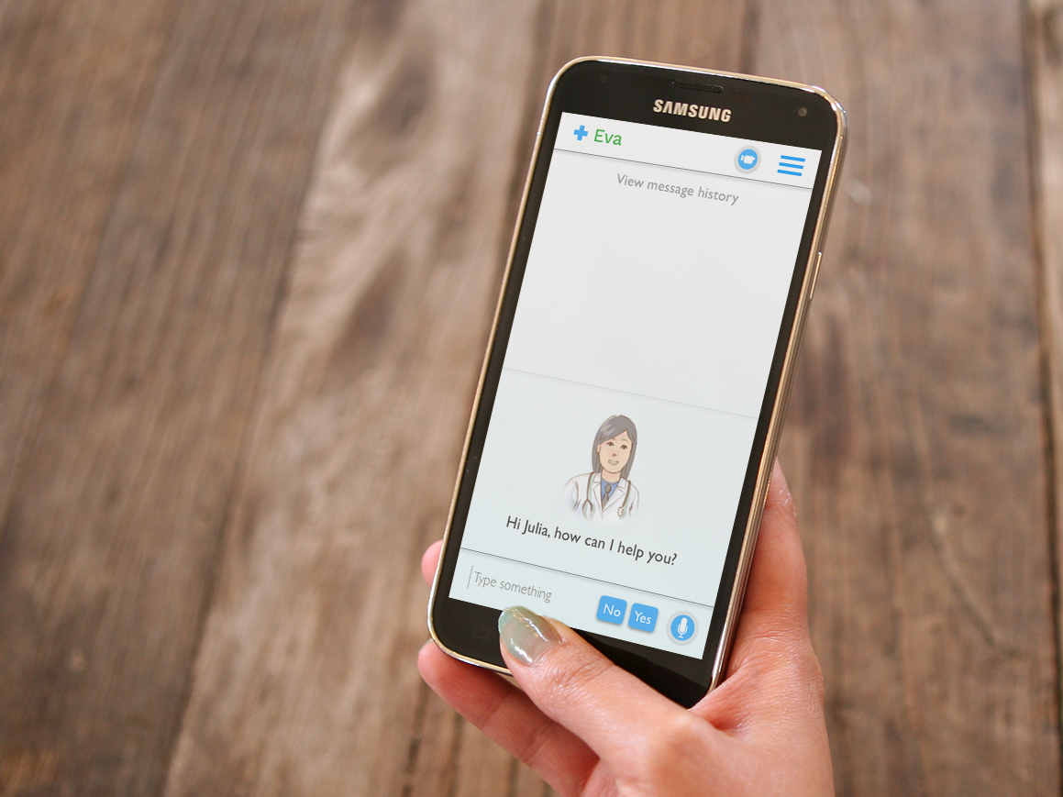

Slide 5
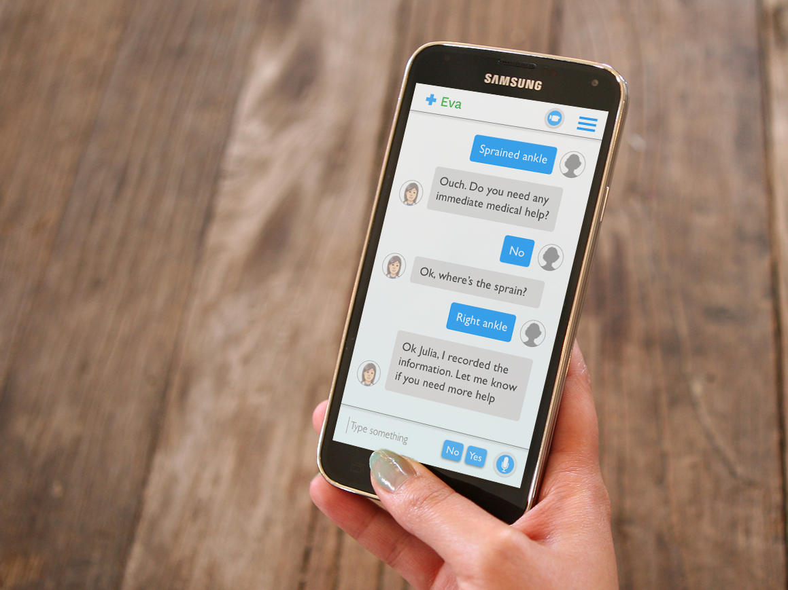

Slide 6
Medium Encounter Lizzy has a headache

Slide 7
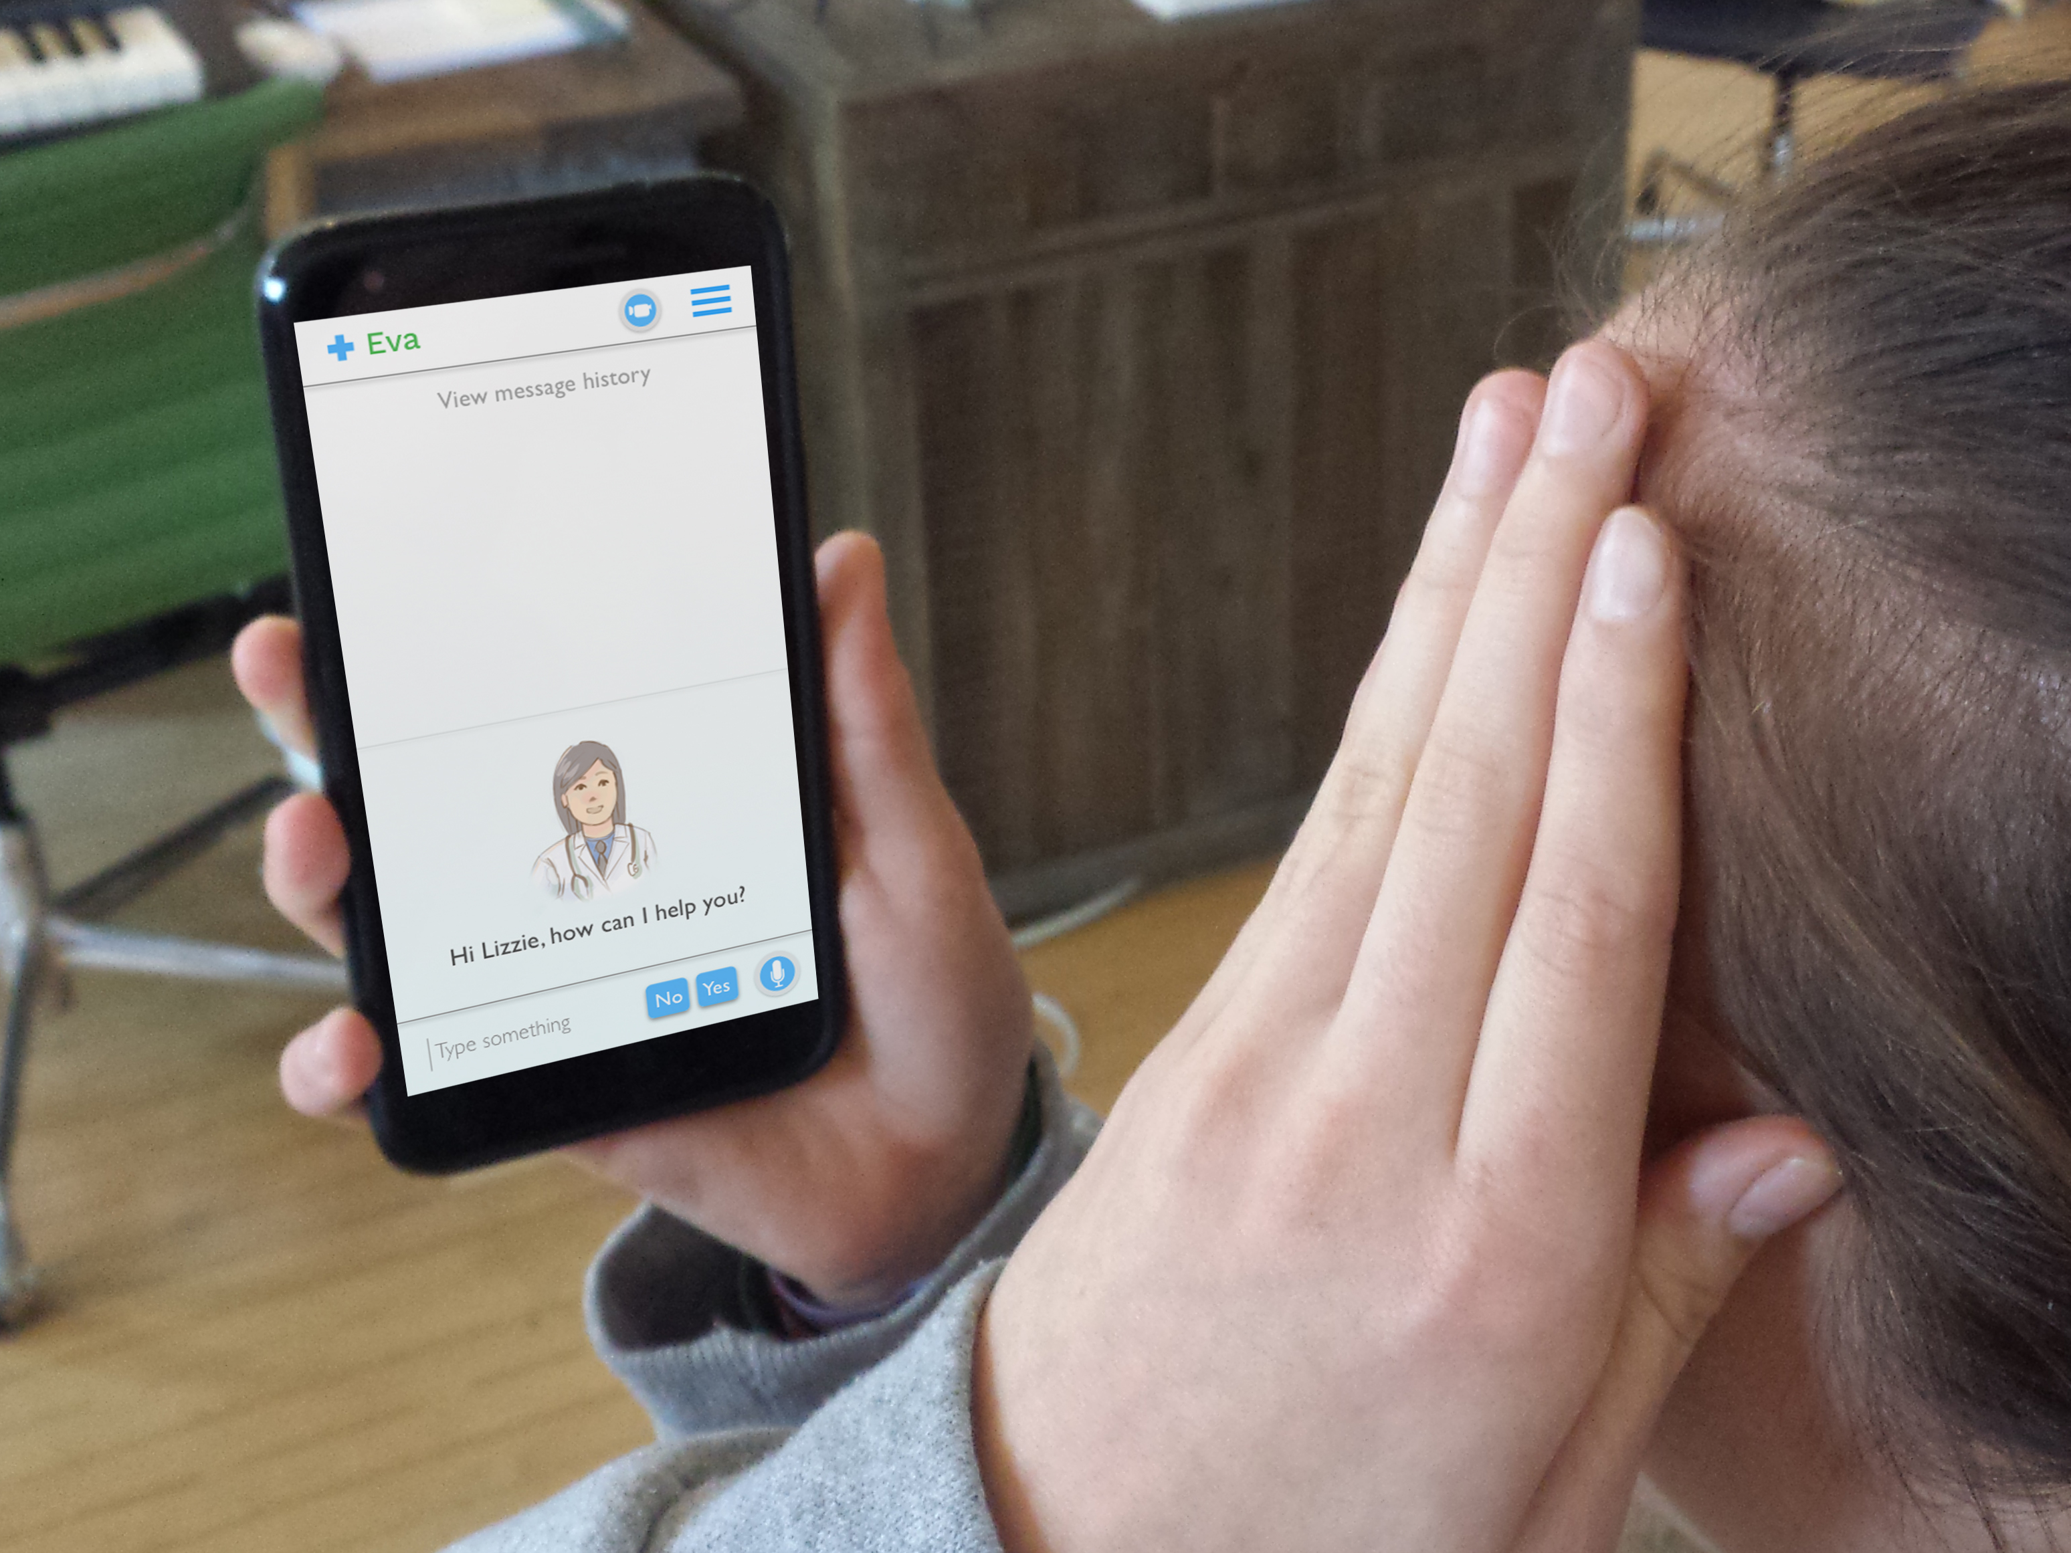

Slide 8
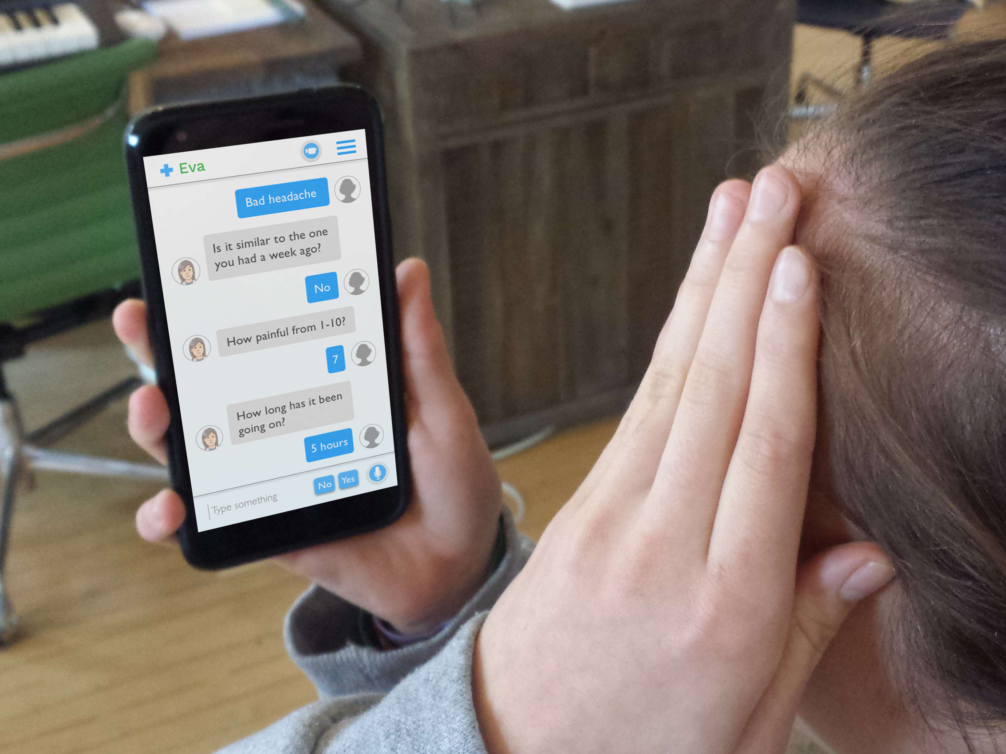

Slide 9
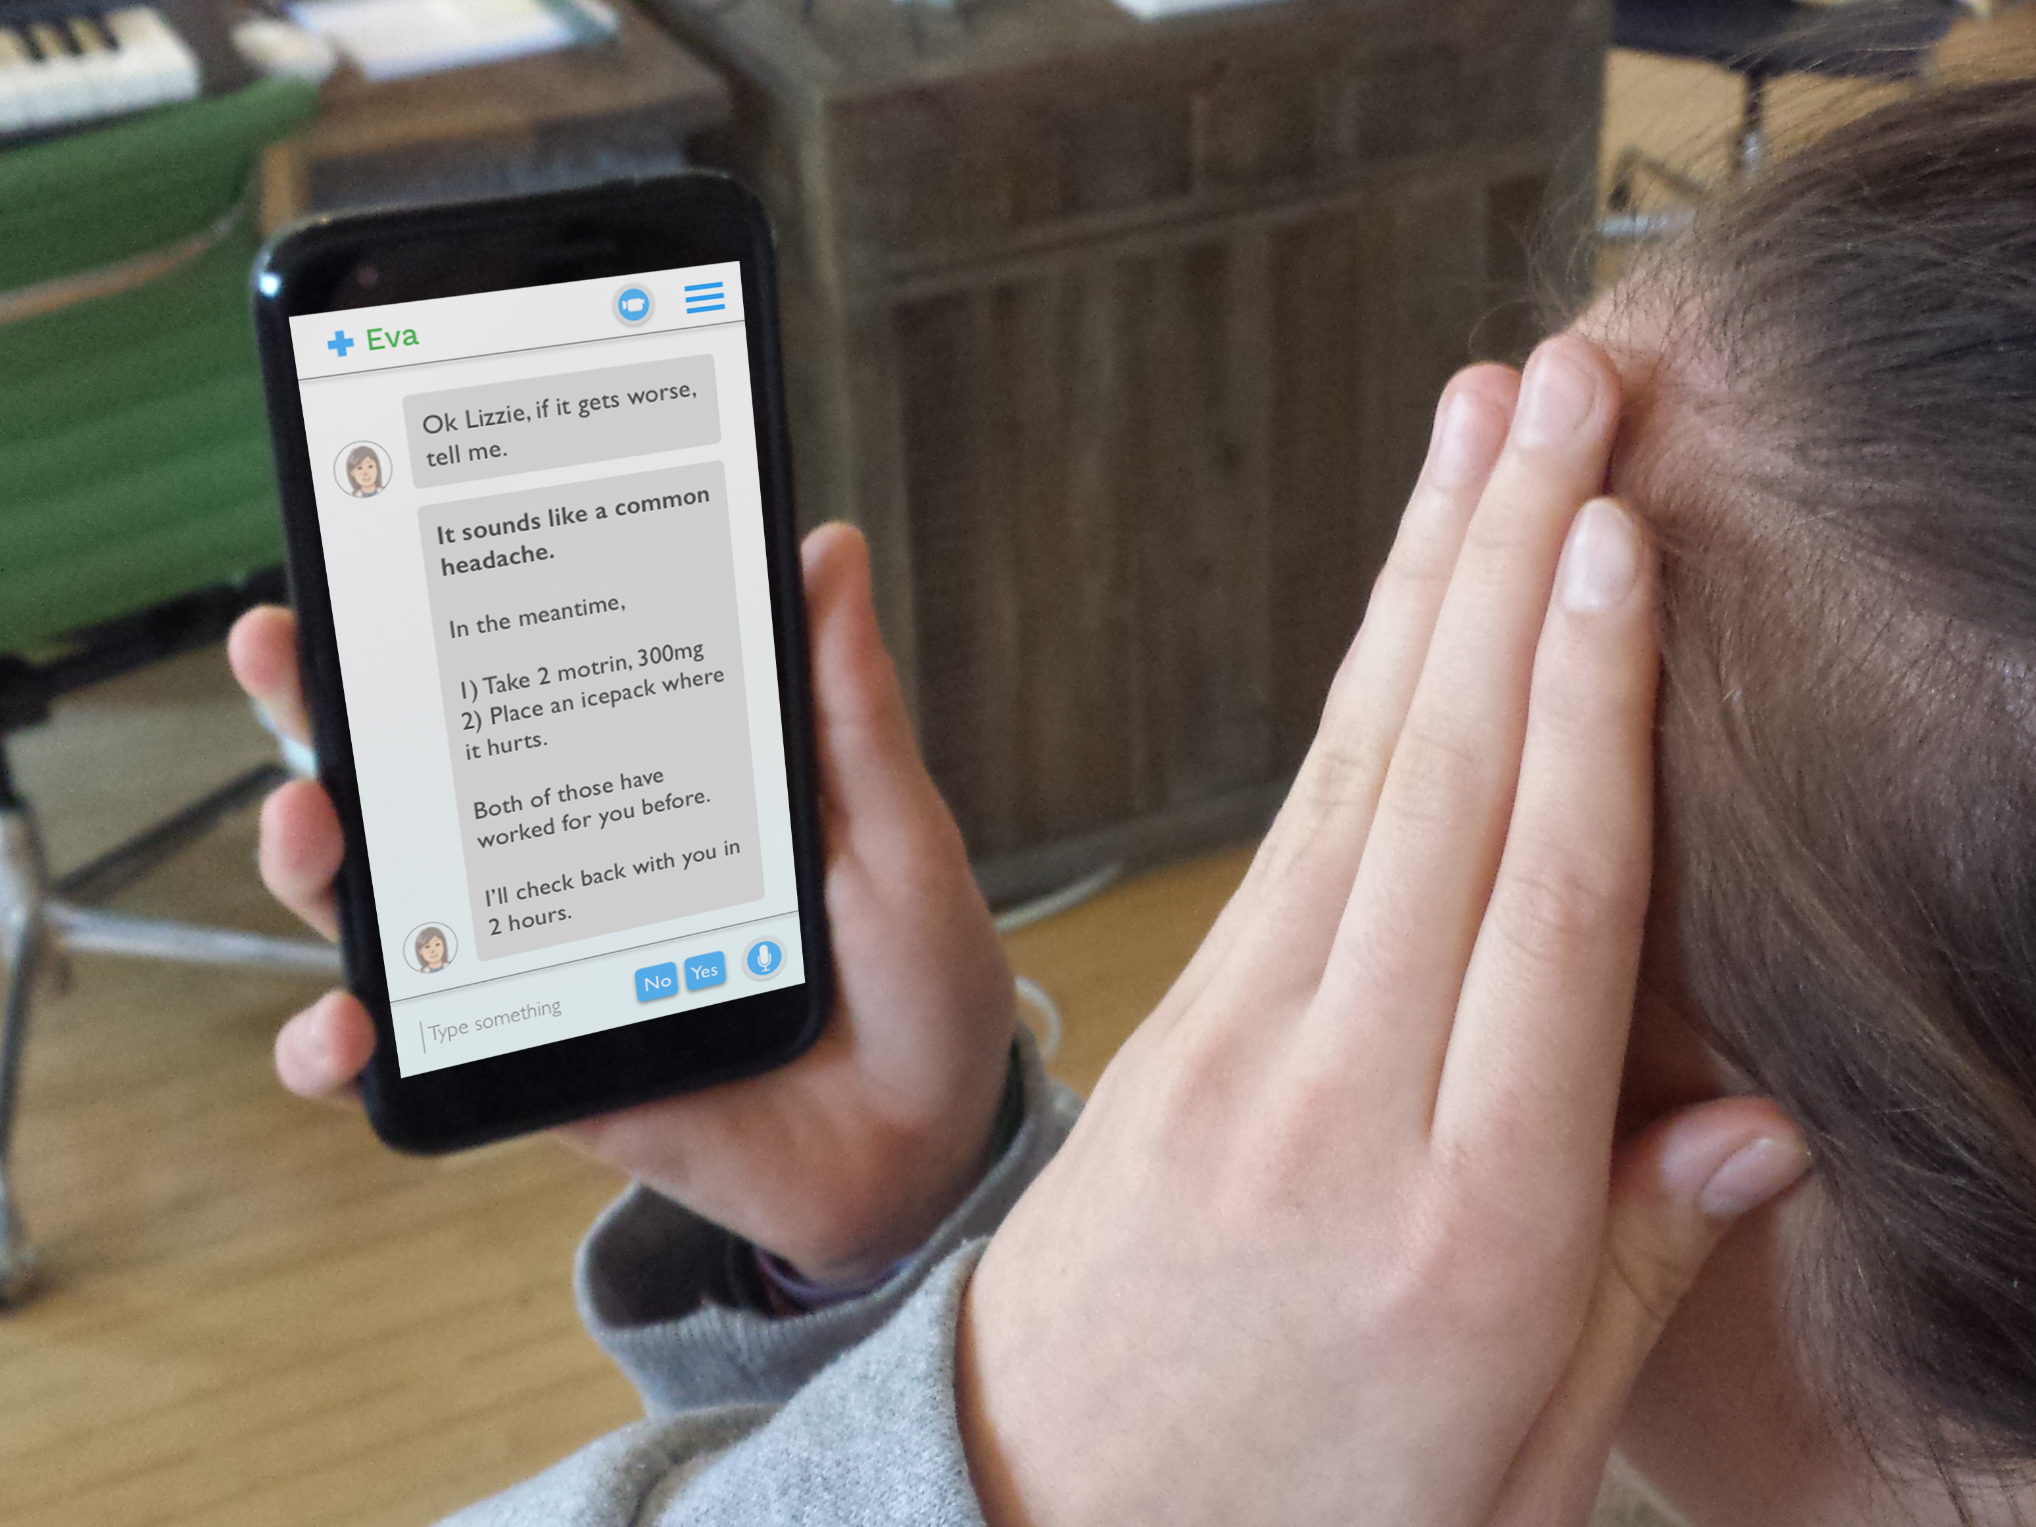

Slide 10
Emergency Encounter Adam has a seizure, 911, and live MD engagement

Slide 11
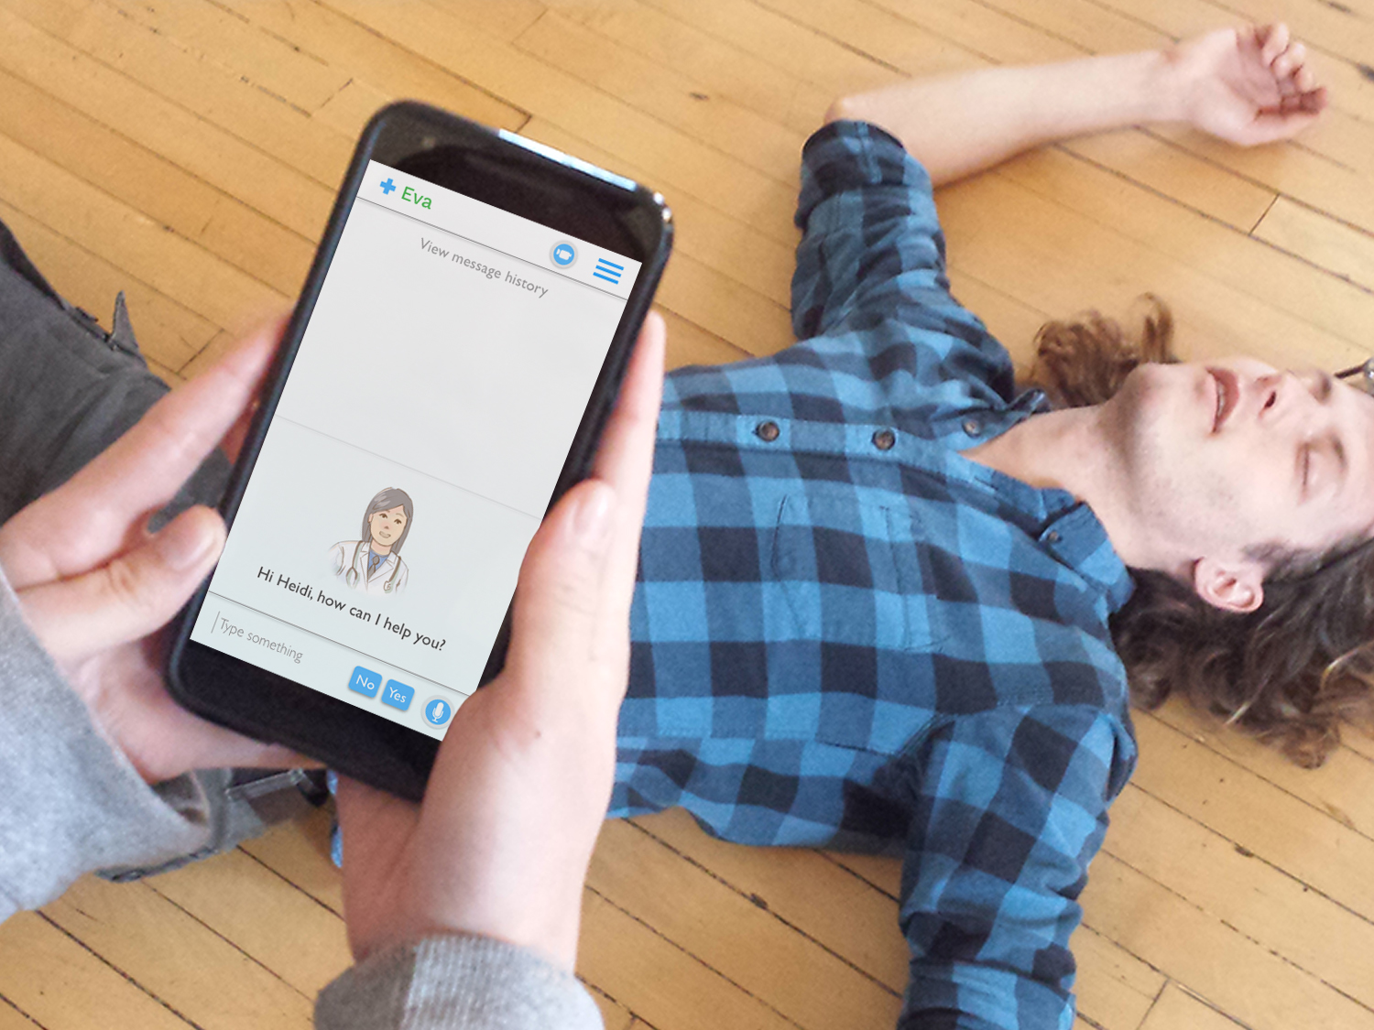

Slide 12
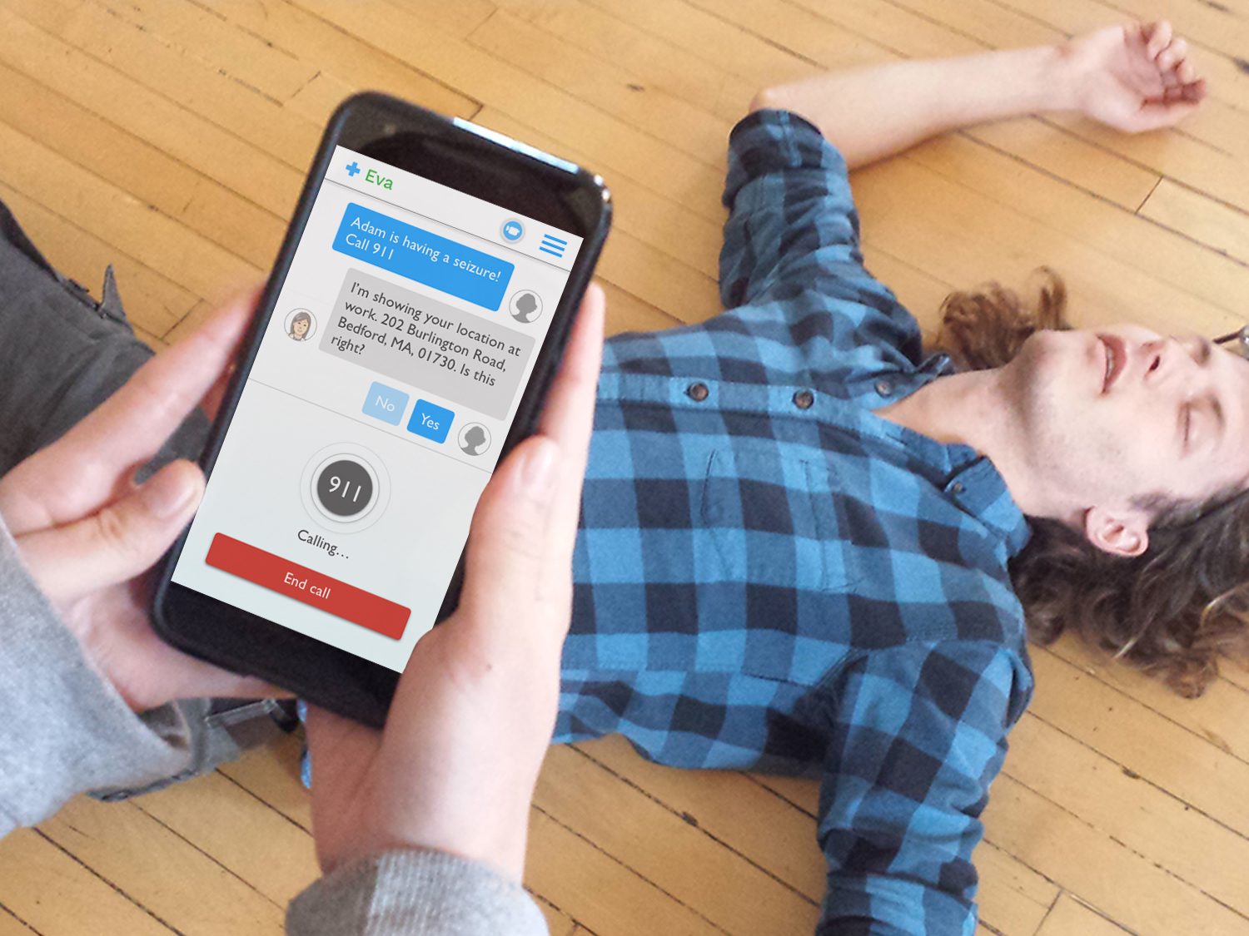

Slide 13
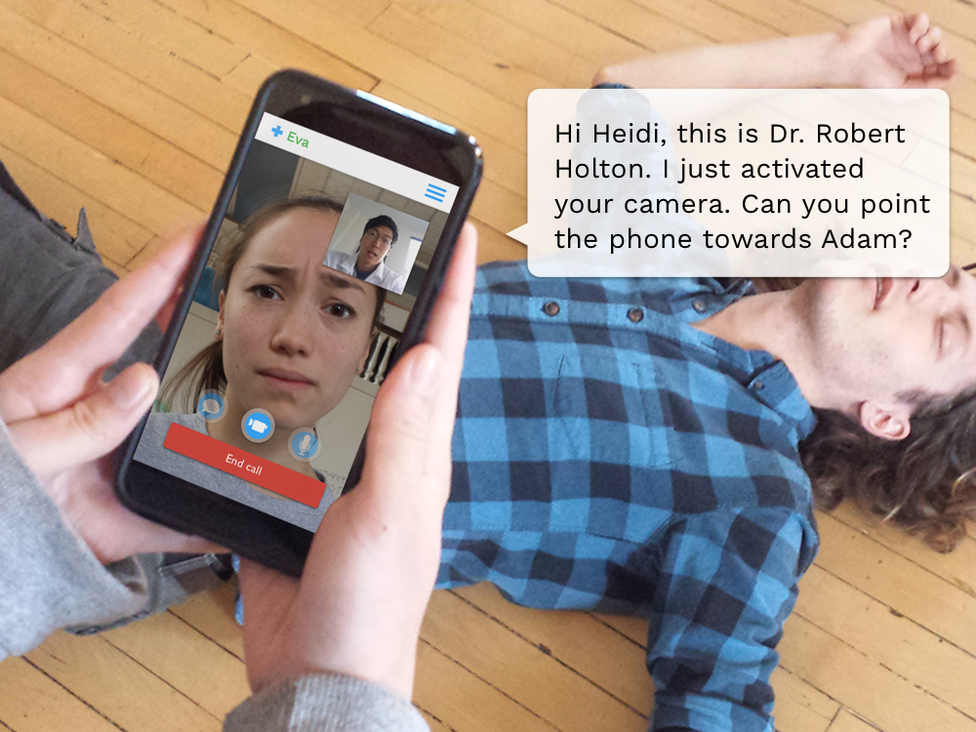

Slide 14
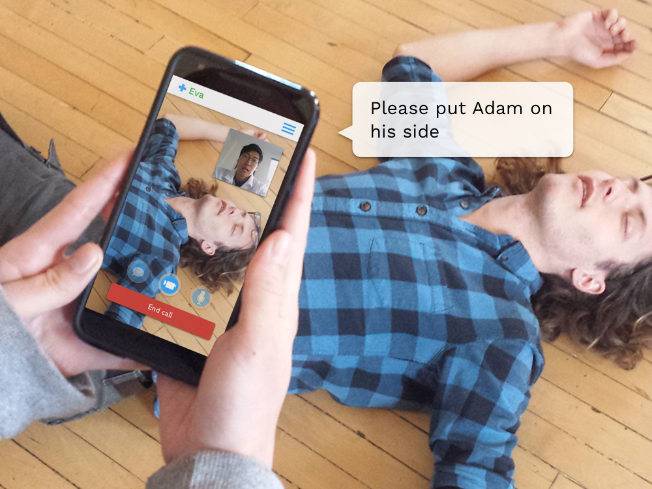

Slide 15
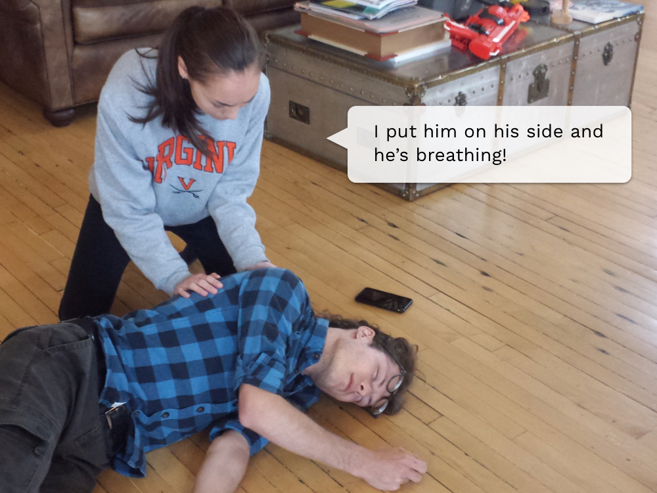

Slide 16
